Slide 1
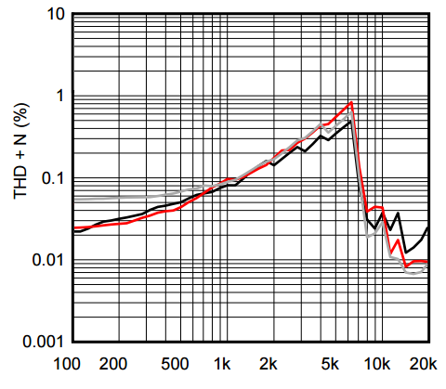
THD+N Estimation
Accurate SNR and THD estimation
A-weighting IEC 61672:2003 and CCIR/ITU-468
Suitable from voice sampling rate to PDM
Code validated with silicon manufacturers

Slide 2
Overview
The purpose of this MATLAB program is to compute the signal to noise ratio (SNR) of audio files.
Input files can be of various formats : pulse-density modulation (PDM), raw samples (PCM), in text or binary format.
The program concentrates its analysis in the audio and voice bands.
It can weight the results using ITU/CCIR or using dBA curves.
Optionally, it can cope with jitter and other types of distortions before computing SNR.
Code folder is http://firmware-developments.com/WEB/P6x/THDN/ :
DOC holds this file
CODE is the Matlab code extracts and some data
Encrypted_file stores the Matlab program you can decipher with a key we send you by email.

Slide 3
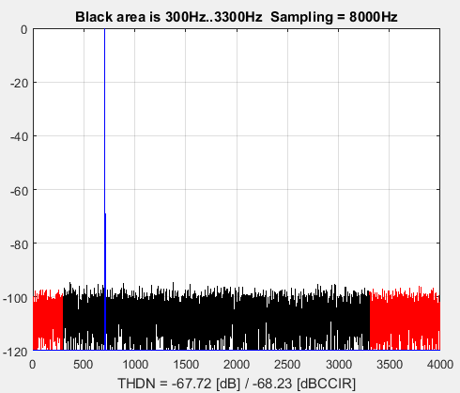
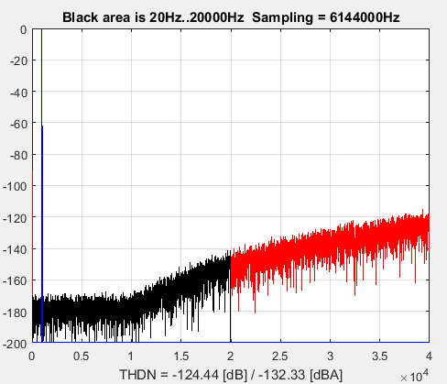
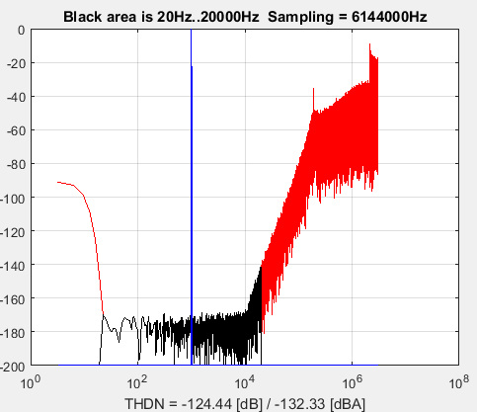
Examples
Example of analysis for a file sampled at 8kHz
Example of analysis at 6.144MHz PDM data rate using linear and logarithm scale.

Slide 4
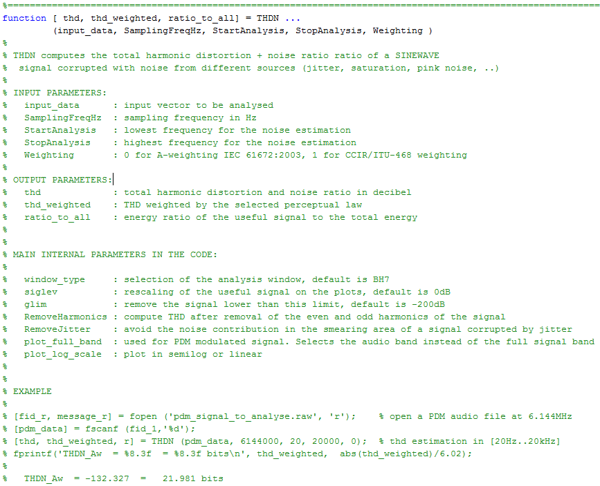
Function header

Slide 5
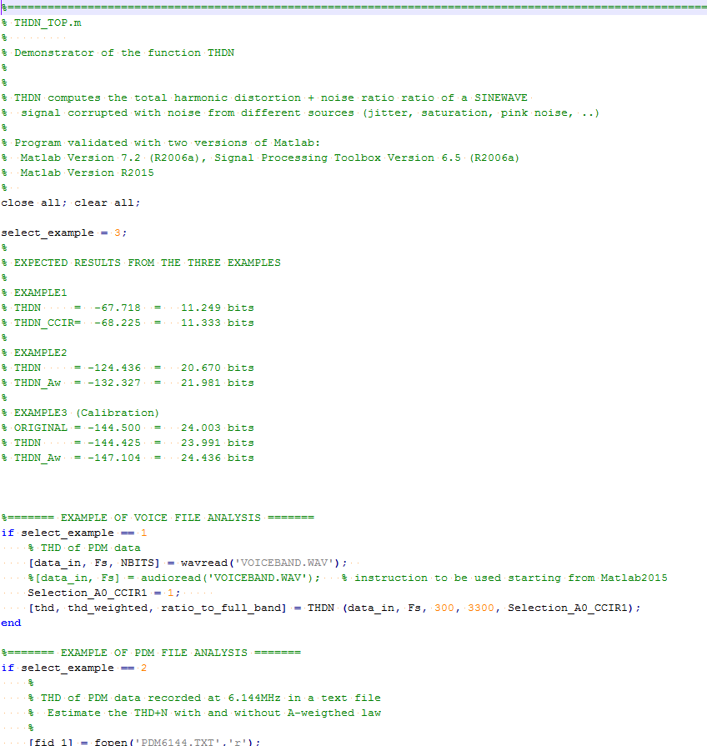
Extract of the “top”

