Slide 1
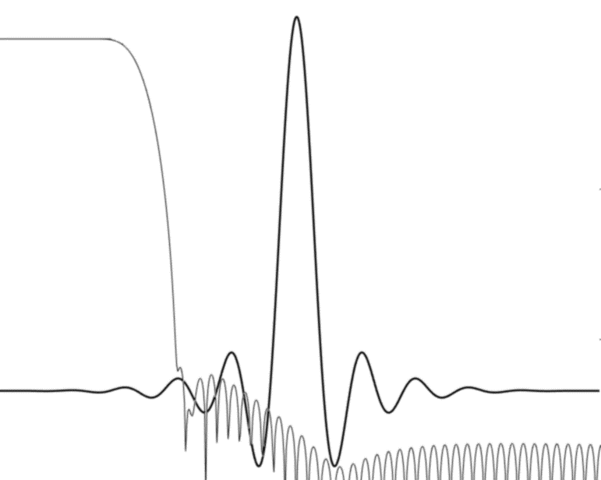
LOW-COMPLEXITY ARBITRARY SAMPLE-RATE CONVERTER

Slide 2
Overview
This program implements an adjustable interpolator used for the sampling rate conversion (SRC).
The code is ported to Cortex-M4 / M7 and Cortex-A with or without NEON.
Several configurations are precomputed and can be prepared depending on the memory size constraints of your device.
The bit-exact demonstration files and executable (BATCH_SRC.BAT) are located at :
http://firmware-developments.com/WEB/P6x/SSRC_M4/DEMO/

Slide 3
Programming interfaces
The program works from a pre-computed coefficient-set corresponding to a low-pass filter. A Matlab/Octave program generates the coefficients from different parameters: computation load, sharpness of the filter, resampling accuracy, memory size constraints.
The public APIs of the programs are:
Returning the amount of required memory from input parameters : input and output sampling rates, samples format.
Create an instance of the sample-rate converter and initializing it
Process one instance, taking an input mono audio buffer and returning the new samples in an output buffer with the number of interpolated output samples.

Slide 4
Details
The focus of this program is run as fast as possible. To do so, the computation is done with one single filtering step.
Sampling-rate accuracy. The SRC is computing the output samples from a polyphase FIR (finite impulse response) filter. The number of phase in the filter depends on the least common multiples between the input and output frequencies. For example, going from 16kHz to 48kHz means 3 phases because 16kHz x 3 = 48kHz. But going from 11.025kHz to 32kHz means 1280 phases because 11.025kHz x (1280/441) = 32kHz.
If your sampling frequencies are not corresponding to the number of phases of the filter, the program will arrange to find the closest approximation. For example, a filter shape of 12 phases used to go from 44.1kHz to 48kHz cannot use the ideal ratio (160/147) but will use (12/11) instead, resulting in 0.2% sampling error. (44.1kHz x (12/11) = 48.1kHz).
Complexity. The minimum complexity in the polyphase filtering is the minimum number of taps in the FIR to process one sample. Usually this number is 24, but can be set at different values (from 8 to 32 for example) depending on the computation capabilities of the processor and the shape of the filter.
Memory. The flash memory consumption mainly comes from the filter coefficients. The size is (4 bytes) x (number of phases) x (minimum number of taps). For example with 12 phases and 24 taps the size of table of coefficients is 1152 bytes.
The RAM memory is (minimum number of taps x (1 + (high sampling rate / low sampling rate)).
The number of samples in the output buffer is equal to (input buffer size) x (output sampling rate / input sampling rate). When this number is not an integer the number of output samples vary from one process call to the other.

Slide 5
Algorithm complexity numbers
The shape of the pre-computed low-pass filter is used to create a polyphase FIR. The number of taps (NFIR in the table below) is arranged to be a multiple of 4 to be compatible with NEON vector operations. In the example below the minimum FIR length is set to 24 and the number of taps is proportional to the interpolation or decimation ratio. The table gives the number of millions of multiply-accumulate (MAC) operations per second. For example the interpolation from 8kHz to 16kHz takes 0.384 Million MAC/s.
The critical loop of the program consists in a dot-product operation, the speed of which depends on the micro-architecture of the processor.
8000 => 16000 NFIR= 24 L= 1280 / M= 640 MMAC/s= 0.3840
8000 => 22050 NFIR= 24 L= 1323 / M= 480 MMAC/s= 0.5292
8000 => 24000 NFIR= 24 L= 1281 / M= 427 MMAC/s= 0.5760
8000 => 32000 NFIR= 24 L= 1280 / M= 320 MMAC/s= 0.7680
8000 => 44100 NFIR= 24 L= 1323 / M= 240 MMAC/s= 1.0584
8000 => 48000 NFIR= 28 L= 1278 / M= 213 MMAC/s= 1.3440
16000 => 8000 NFIR= 48 L= 640 / M= 1280 MMAC/s= 0.3840
16000 => 22050 NFIR= 24 L= 1323 / M= 960 MMAC/s= 0.5292
16000 => 24000 NFIR= 24 L= 1281 / M= 854 MMAC/s= 0.5760
16000 => 32000 NFIR= 24 L= 1280 / M= 640 MMAC/s= 0.7680
16000 => 44100 NFIR= 24 L= 1323 / M= 480 MMAC/s= 1.0584
16000 => 48000 NFIR= 24 L= 1281 / M= 427 MMAC/s= 1.1520
22050 => 8000 NFIR= 64 L= 480 / M= 1323 MMAC/s= 0.5120
22050 => 16000 NFIR= 32 L= 960 / M= 1323 MMAC/s= 0.5120
22050 => 24000 NFIR= 24 L= 1280 / M= 1176 MMAC/s= 0.5760
22050 => 32000 NFIR= 24 L= 1280 / M= 882 MMAC/s= 0.7680
22050 => 44100 NFIR= 24 L= 1280 / M= 640 MMAC/s= 1.0584
22050 => 48000 NFIR= 24 L= 1280 / M= 588 MMAC/s= 1.1520
32000 => 8000 NFIR= 96 L= 320 / M= 1280 MMAC/s= 0.7680
32000 => 16000 NFIR= 48 L= 640 / M= 1280 MMAC/s= 0.7680
32000 => 22050 NFIR= 36 L= 882 / M= 1280 MMAC/s= 0.7938
32000 => 24000 NFIR= 32 L= 960 / M= 1280 MMAC/s= 0.7680
32000 => 44100 NFIR= 24 L= 1323 / M= 960 MMAC/s= 1.0584
32000 => 48000 NFIR= 24 L= 1281 / M= 854 MMAC/s= 1.1520
44100 => 8000 NFIR=128 L= 240 / M= 1323 MMAC/s= 1.0240
44100 => 16000 NFIR= 64 L= 480 / M= 1323 MMAC/s= 1.0240
44100 => 22050 NFIR= 48 L= 640 / M= 1280 MMAC/s= 1.0584
44100 => 24000 NFIR= 44 L= 720 / M= 1323 MMAC/s= 1.0560
44100 => 32000 NFIR= 32 L= 960 / M= 1323 MMAC/s= 1.0240
44100 => 48000 NFIR= 24 L= 1280 / M= 1176 MMAC/s= 1.1520
48000 => 8000 NFIR=148 L= 213 / M= 1278 MMAC/s= 1.1840
48000 => 16000 NFIR= 72 L= 427 / M= 1281 MMAC/s= 1.1520
48000 => 22050 NFIR= 56 L= 588 / M= 1280 MMAC/s= 1.2348
48000 => 24000 NFIR= 48 L= 640 / M= 1280 MMAC/s= 1.1520
48000 => 32000 NFIR= 36 L= 854 / M= 1281 MMAC/s= 1.1520
48000 => 44100 NFIR= 28 L= 1176 / M= 1280 MMAC/s= 1.2348

Slide 6
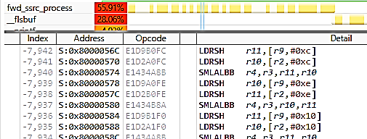
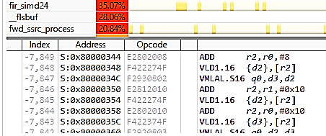
CPU load simulation
The speed simulation was made on DS-5 (v5.27) on the Cortex-A7-FVP model emulating a system clocked at 133MHz with caches enabled. The samples are processed by packets of 16 samples for a conversion from 16kHz to 44.1kHz. The number of generated output samples is : (160k input samples) x (44.1/16 ratio) = 441k samples. The compiler used is armcc with command line: armcc --cpu=Cortex-A7 -O3 --vectorize –g --md –c
Results : 330 system ticks (1ms) are used for the scalar version (99cycles/sample) and 210 ticks for the SIMD version (63cycles/sample)
Numbers are twice lower using the aarch64 model for Cortex-A57, with about the same speed improvement ratio for SIMD.
Scalar filtering Filtering with SIMD instructions

Slide 7
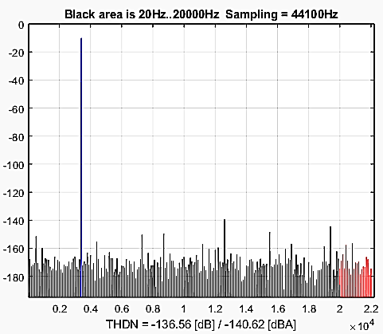
THDN performances – floating-point 32bits
A sine wave (frequency 251Hz and 3400Hz) is resampled.
The computation of the A-weighted THD+N gives numbers larger than 130dB.
The minimum filter length was set to 28 taps.
Sine wave -10dB at 251Hz (THD+N results in dBA)
Fs out=> 8000Hz 16000Hz 22050Hz 24000Hz 32000Hz 44100Hz 48000Hz
8000Hz 150 133 134 134 134 137
16000Hz 147 138 134 151 143 139
22050Hz 143 141 135 138 152 142
24000Hz 145 148 139 136 143 153
32000Hz 144 147 143 142 136 142
44100Hz 143 143 148 143 144 135
48000Hz 143 146 143 148 150 138
Sine wave -10dB at 3400Hz (THD+N results in dBA)
Fs out=> 8000Hz 16000Hz 22050Hz 24000Hz 32000Hz 44100Hz 48000Hz
8000Hz
16000Hz 126 138 138 128 137
22050Hz 140 127 132 135 135
24000Hz 141 132 132 144 139
32000Hz 149 143 143 140 137
44100Hz 145 148 145 143 133
48000Hz 147 143 148 145 138

Slide 8
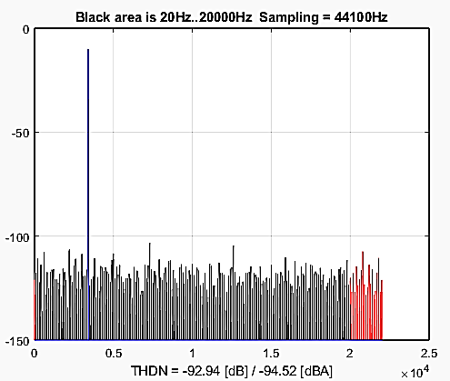
THDN performances – fixed-point 16bits
A sine wave (frequency 251Hz and 3400Hz) at -10dB FS is resampled at several frequencies.
The computation of the A-weighted THD+N gives numbers in the 95dBA range.
The minimum filter length was set to 24 taps.
Fs out=> 8000Hz 16000Hz 22050Hz 24000Hz 32000Hz 44100Hz 48000Hz
8000Hz 95 93 95 94 94 95
16000Hz 97 93 95 96 95 96
22050Hz 91 93 94 94 97 95
24000Hz 97 96 93 94 95 97
32000Hz 97 96 92 94 95 97
44100Hz 90 92 97 93 94 95
48000Hz 98 97 92 97 97 95
Sine wave -10dB at 3400Hz (THD+N results in dBA)
Fs out=> 8000Hz 16000Hz 22050Hz 24000Hz 32000Hz 44100Hz 48000Hz
8000Hz
16000Hz 94 96 95 95 97
22050Hz 93 93 94 95 95
24000Hz 93 93 94 94 96
32000Hz 99 93 94 96 97
44100Hz 91 97 93 94 95
48000Hz 97 91 97 93 95

Slide 9
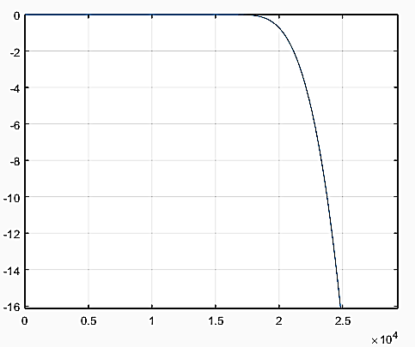
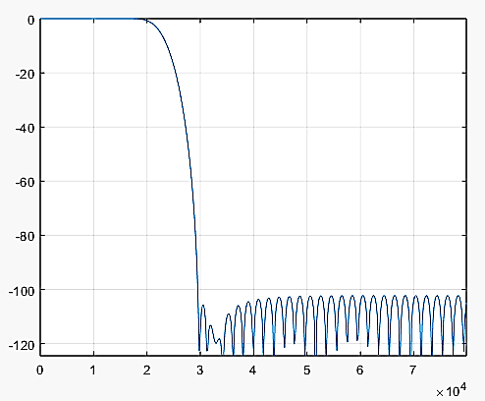
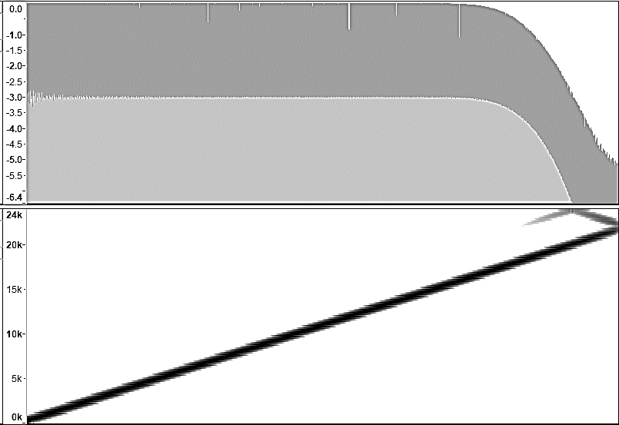
Spectral flatness
The computation do not introduce ripples in the output samples.
The two plots on the left are the spectrum shape of the of the 24-taps filter.
The right-plot is the wave and spectrogram of the fixed-point Q15 processing result.
In this example, the spectral flatness at 1dB is guaranteed up to 19500Hz.

