Slide 1
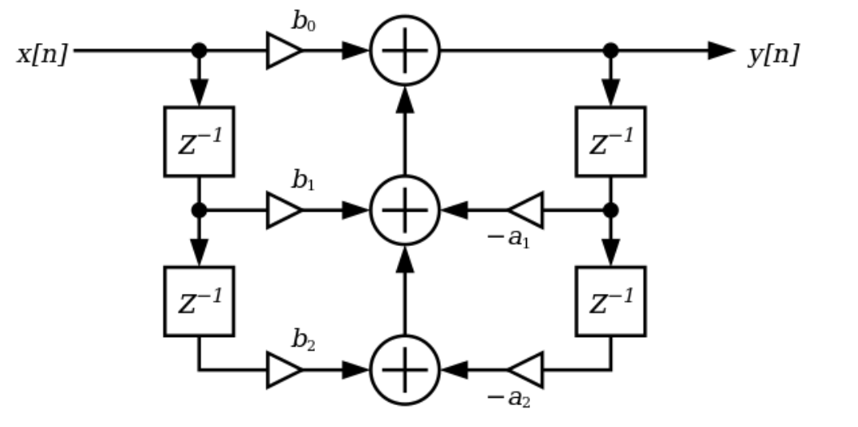
BIQUAD FILTER FOR NEON

Slide 2
Overview
This program implements the filtering of a cascade of biquads. The hypothesis are :
The processing is made by blocks of floating point audio samples, mono.
The input samples are contiguous, 32bits each, IEEE format.
There are 5 coefficients for each filter of the cascade, coded in floating point 32bits
The filter has 4 memory cells allocated by biquad.
The memory states of each biquad is contiguous.
The buffer length is a multiple of 4.
The code has MIT license
The header and example of call is provided as example here :

